Slide 1

Title Slide
Image Similarity
April 30th , 2020

Slide 2
Problem Statement
Image-Similarity
Law enforcement agencies often receives huge dump of images.
Given an image of interest, they often need to find other similar images from the past.
Example use case : Identify a criminal using crime-scene images through his/her MO.
Deliverable
A plugin for Media Viewer engine developed by Jagath, which can be used to find similar images, given an input query image.

Slide 3
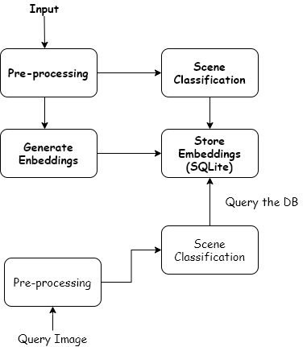
Technical Approach
Input – Directory of Images for which you want to run similarity.
Preprocessing – Reshape to (224,224,3) tensor and normalization.
Generate Embeddings – Forward pass through pre-trained deep-ranking model. Output of the second-last layer as representation of the image. (150528 -> 4096).
Scene Classification – Identify the type of scene in the image.
Storage – Stores image representation and scene information in SQLite database for future similarity search.

Slide 4
Dan’s Questions
Wondering how this will work at scale & what are the benchmarks of this
How much data has been thrown at it
Can we do this per project, per case?
Is it capable of image similarity across every investigation?
Not certain how this would be used - maybe incorporate face data

Slide 5

What will I do next week ?
Prepare for the final presentation ?
Hopefully, hear back from Dan !

Slide 6
Closing Slide

